Slide 1
Stack & Queue and Linked List
By: Amber Hayat
ahayat@ddn.upes.ac.in

Slide 2
Data Structure
In computer science, a data structure is a particular way of storing and organizing data in a computer’s memory so that it can be used efficiently.
Categories of Data Structure:
The data structure can be classified in to major types:
Linear Data Structure
Non-linear Data Structure

Slide 3
Linear Data Structure:
A data structure is said to be linear if its elements form any sequence.
There are basically two ways of representing such linear structure in memory.
The common examples of linear data structure are
Arrays
Queues
Stacks
Linked lists

Slide 4
Non-linear Data Structure:
This structure is mainly used to represent data containing a hierarchical relationship between elements.
e.g. graphs, trees

Slide 5
Data Structures Operations
Traversing: accessing each record/node exactly once so that certain items in the record may be processed. (This accessing and processing is sometimes
called “visiting” the record.)
Searching: Finding the location of the desired node with a given key value,or finding the locations of all such nodes which satisfy one or more conditions.
Inserting: Adding a new node/record to the structure.
Deleting: Removing a node/record from the structure.

Slide 6
Stack-Introduction
Stack is a LIFO (last in first out) structure.
It is an ordered list of the same type of elements.
A stack is a linear list where all insertions and deletions are permitted only at one end of the list.
When elements are added to stack it grow at one end.
Similarly, when elements are deleted from a stack, it shrinks at the same end.

Slide 7
Basic features of Stack
push() function is used to insert new elements into the Stack and pop() is used to delete an element from the stack. Both insertion and deletion are allowed at only one end of Stack called Top.
Stack is said to be in Overflow state when it is completely full and is said to be in Underflow state if it is completely empty

Slide 8
Algorithm for PUSH operation
begin procedure push: stack, data
if stack is full
return null
end
top ← top + 1
stack[top] ← data
end procedure

Slide 9
Algorithm for POP operation
begin procedure pop: stack
if stack is empty
return null
endif
data ← stack[top]
top ← top - 1
return data
end procedure

Slide 10
Array Representation of Stack
#include<stdio.h>
#include<conio.h>
#include<process.h> //for exit()
#define MAX 5 //Maximum number of elements that can be stored
int top=-1,stack[MAX];
void push();
void pop();
void display();

Slide 11
void main()
{
int ch;
while(1) //infinite loop, will end when
choice will be 4
{
printf(“*** Stack Menu ***”);
printf(“\n1.Push\n2.Pop\n3.Display\n4.Exit”);
printf(“nnEnter your
choice(1-4):”);
scanf(“%d”,&ch);

Slide 12
scanf(“%d”,&ch);
switch(ch)
{
case 1: push();
break;
case 2: pop();
break;
case 3: display();
break;
case 4: exit(0);
default: printf(“nWrong
Choice!!Press any key….”);
getch();
}
}
}

Slide 13
void push()
{
int val;
if(top==MAX-1)
{
printf(“nStack is full!!Press any
key….”);
getch();
}
else
{
printf(“nEnter element to
push:”);
scanf(“%d”,&val);
top=top+1;
stack[top]=val;
printf(“nPress any
key….”);
getch();
}
}

Slide 14
void pop()
{
if(top==-1)
{
printf(“nStack is empty!!Press any key….”);
getch();
}
else
{
printf(“nDeleted element is %dnPress any key….”,stack[top]);
top=top-1;
getch();
}
}
void display()

Slide 15
{
int i;
if(top==-1)
{
printf(“nStack is empty!!Press any key….”);
getch();
}
else
{
printf(“nStack is…n”);
for(i=top;i>=0;–i)
printf(“%dn”,stack[i]);
printf(“nPress any key….”);
getch();
}
}

Slide 16
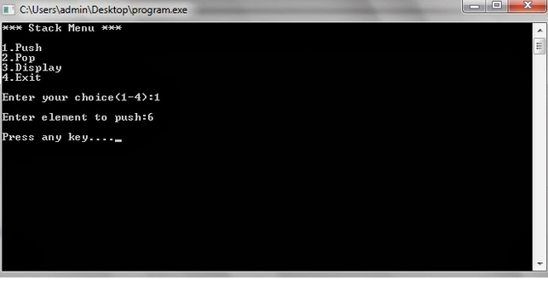
Output

Slide 17
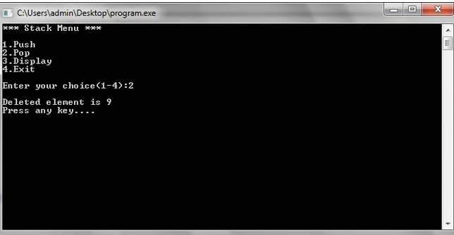

Slide 18
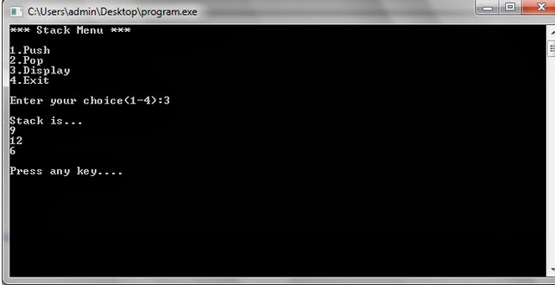

Slide 19
Applications of Stack
Recursive Function
Expression Evaluation
Expression Conversion
Infix to Postfix
Infix to Prefix
Postfix to Infix
Prefix to Infix
Towers of hanoi

